Slide 1

TRAFFIC SIGN RECOGNITION USING DEEP LEARNING BY NEURAL NETWORKS
SRM Institute of Science and Technology, Ramapuram Campus
DEPARTMENT OF COMPUTER SCIENCE AND ENGINEERING
Batch No: 9
DETAILS OF THE PROJECT
Kranthi Reddy RA1711003020467
Pranav Raju RA1711003020473
Thirupathi Kota RA1711003020456
SUPERVISOR DETAILS
Ms.V.Surya
Assistant Professor (O.G)
Computer Science and Engineering
SRM Institute of Science & Technology
Ramapuram Campus, Chennai

Slide 2
OBJECTIVE
The fundamental function of this system is to capture the image or video so that it can be further processed.
In fact, the camera should be properly calibrated and its dynamic range should be adjusted before capturing any scene.
The main objective of the research on TSDR is to improve the robustness and efficiency of the TSDR system.
If the cameras are placed too far away, then the image captured will be blurred and cannot be detected accurately. Hence the distance of camera from the image determines the quality of image.

Slide 3
SCOPE
In order to solve the concerns over road and transportation safety, automatic traffic sign detection and recognition (TSDR) system has been introduced.
An automatic TSDR system can detect and recognise traffic signs from and within images captured by cameras or imaging sensors.
For applying the TSDR system in real-time environment, a fast algorithm is needed. As well as dealing with these issues, a recognition system should also avoid erroneous recognition of non-signs.

Slide 4
ABSTRACT
Now a days with rapid development of society and economy, automobiles have become one of the most common modes of transportation for every individuals.
Traffic road sign detection is very crucial in transport system. The aim of the project is to detect the type of the traffic signal and act according to that.
The entire action was recorded in a video sequence by an on board camera attached to the vehicle.
The main theme of the project is for the application of driverless cars and also traffic recognition is one of the most challenging problem for driving assistance system.

Slide 5
INTRODUCTION
Traffic-sign recognition (TSR) is a technology by which a vehicle is able to recognize the traffic signs put on the road e.g. "speed limit" or "children" or "turn ahead". This is part of the feature collectively called as Advanced Driving Assistance System(ADAS).
It uses image processing techniques to detect the traffic signs.
Traffic signs give information about the road conditions ahead, provide instructions to be followed at the major crossroads or junctions, warn or guide drivers, and ensure proper functioning of road traffic.

Slide 6
Being unaware of road signs is akin to throwing caution to the wind. It can lead to loss of life and property.
For an Intelligent Transportation System Smart vehicle are must. Smart vehicles reduce number of accidents happening around the world.
An automatic TSDR system can detect and recognise traffic signs from and within images captured by cameras or imaging sensors.
A visual-based traffic sign recognition system can be implemented on the automobile with an aim of detecting and recognizing all emerging traffic signs.

Slide 7
LITERATURE SURVEY
Title : Encoding Rich Frequencies for Classification of Stroke Patients EEG Signals
Name of the Authors : Fawaz Sammani, Kok Swee Sim, and Shing Chiang Tan.
Year of Publishing : 2017
Concept and Algorithm Used : Deep Learning and, Multi-Layered Perceptron (MLP) and Decision-Trees algorithms are used.
Advantage : The model could potentially assist a medical doctor in analyzing stroke brain images with high accuracy rates. It can also be useful for rehabilitation centers to monitor the progress of stroke patients.
Drawback : The main drawback of using this EEG Signals is its Poor Spatial Resolution of Recordings.

Slide 8
Title : Traffic Sign Detection Algorithm Based on Deep Convolutional Neural Network
Name of the Authors : Xiong Changzhen, Wang Cong and Ma Weixin.
Year of Publishing : 2016
Concept and Algorithm Used : Neural Networks and deep convolutional neural network using region proposal network in Faster R-CNN.
Advantage : The experimental results show that the traffic sign detection rate of the algorithm is above 99% and the detection time is towards real-time in video sequences. It takes only about 51.5 ms average detection time for one frame with the resolution of 640h 480 video sequence. And it is robust to various interferences.
Drawback : The system doesn’t show how to obtain accurate ground truth and the class of the sign detected automatically. Also the system is not responding for a multiple set of images in a single frame.

Slide 9
Title : Traffic Sign Detection and Pattern Recognition using Support Vector Machine
Name of the Authors : Kiran C.G, V. Prabhu, Abdu Rahiman V. and Rajeev K.
Year of Publishing : 2009
Concept and Algorithm Used : Machine Learning and Support Vector Machines algorithms are used.
Advantage : The system uses colour segmentation, shape classification and pattern recognition and produces an output of 75.19% achieve in signal and sign recognition. The main advantage is response time is of 64.2 ms.
Drawback : The system has certain drawbacks that its achievement rate is less and misses recognition of certain signs when it is left for real-time scenario. Also the hue saturations cause delay in recognition of data.

Slide 10
Title : Detection and Recognition of Traffic Signs based on RGB to Red Conversion.
Name of the Authors : Mr.Mohith Bhairav Mahatme, Mrs.Sonia Kuwelkar.
Year of Publishing : 2017
Concept and Algorithm Used : Image Processing and Single Layer Perception algorithm.
Advantage : The system has an accuracy of 93.25% in detection and recognition of traffic signs.
Drawback : It uses HSV colour segmentation process(Hue-Saturation-Value).In case of outdoor Images ,the colour is sensitive to variation in lightening. Hue becomes meaningless. So, it becomes hard for the light colour to find out.

Slide 11
EXISTING SYSTEM
The system is based on neural networks in which it uses a image processing followed by deep neural network algorithms.
The main Part of the system is that it uses a multi level layers of neural networks for data recognition to show an output in a clear crystal manner with an accuracy of precision of 97%.
The system has a support of high definition camera and the distance between the object and the camera is adjusted so that a clear cut is captured every time in real scenario.
The system also supports multiple set of images in a single frame when images are passed on by 45fps.

Slide 12
PROPOSED SYSTEM
The fundamental function of Proposed system is to capture the image or video so that it can be further processed.
The position and resolution of cameras acquiring the images of signs are the main concern.
The traffic sign detected in the image is small and noisy if captured with a low resolution camera and the image would not be detected efficiently.
In this system we use TensorFlow and Python as our software requirements for implementing deep learning algorithms on training the data and testing it by the convolutional layers of neural networks.

Slide 13
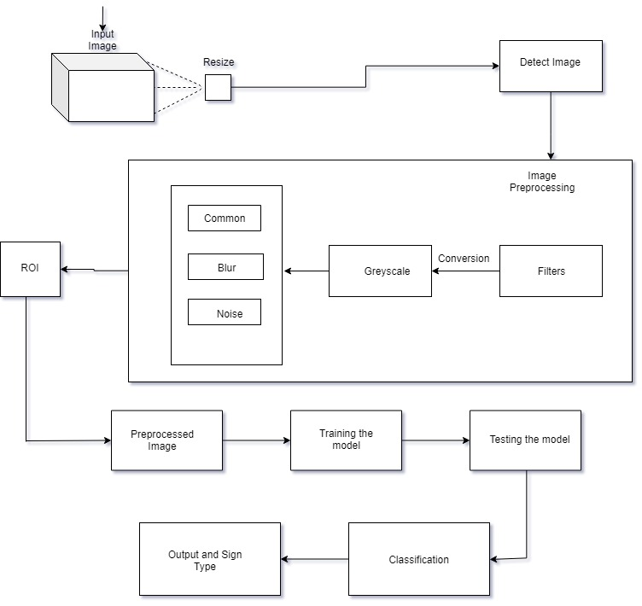
ARCHITECTURE DIAGRAM

Slide 14
MODULES
Prepare a Dataset of images
-Training set
Image Pre processing
Network Structure
-Convolution
-Normalization
-Pooling
-Output Layer
Testing and Recognition

Slide 15
CONCLUSION
Aiming at the problem of traffic sign detection and recognition, this paper presents a traffic sign detection and recognition method based on image-processing and deep neural networks .
Comparisons of each stage by training and validating the dataset makes our model good fit and helps in the output prediction .
As a whole, this method can reach the need of real time and accuracy for the detection and recognition of traffic sign .

Slide 16
REFERENCES
Encoding Rich Frequencies for Classification of Stroke Patients EEG Signals. Authors: Fawaz Sammani, Kok Swee Sim , and Shing Chiang Tan.
Traffic Sign Detection Algorithm Based on Deep Convolutional Neural Network. Authors: Xiong Changzhen, Wang Cong, Ma Weixin, Shan Yanmei.
Traffic Sign Detection and Pattern Recognition using Support Vector Machine. Authors: Kiran C.G, Lekhesh V. Prabhu, Abdu Rahiman V and Rajeev K.
Detection and Recognition of Traffic Signs based on RGB to Red Conversion. Authors: Mr . Mohith Bhairav Mahatme, Mrs . Sonia Kuwelkar.

